Slide 1

The Equality of Upward Mobility Project
Hans Kullberg
May 23rd, 2019
General Assembly – Data Science 32
Washington DC

Slide 2
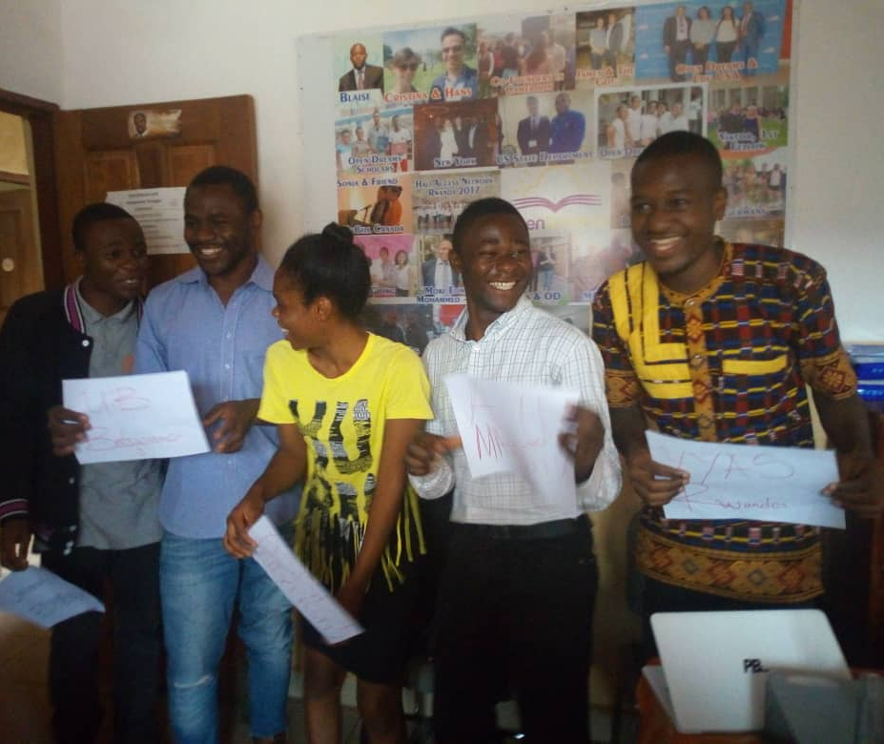



Background & Business Objective
Open Dreams (founded 2013) bridges the divide between university education scholarship opportunities & high-achieving scholars around the world using a virtual mentorship network
.
Of critical importance, Open Dreams helps scholars select amongst global universities based on their ability to provide upward mobility via education. For school selection, it’s important to know: Which schools provide a better chance for upward mobility? And what are the qualities attributable to higher Upward Mobility?
College Education is a big topic of national debate (2020 Elections) due to student loan burden & perceived lack of upward income mobility. Most students, overtly or unwittingly seek a college education with the hope and goal of climbing the income mobility ladder.

Slide 3
The Dataset
The Equality of Opportunity Project
www.equality-of-opportunity.org/data/
Mobility Report Cards: The Role of Colleges in Intergenerational Mobility
Authors (Economists): Chetty, Friedman, Saez, Turner, and Yagan (2017)
Mobility Statistics and Student Outcomes by College & Birth Cohort
Key Data: Parent Quintiles, Student Income Quintiles (~around age 30), School Information
Data Collection: Birth Cohorts around 1980-82, Observations taken in 2000 & 2013
Cost of Living Index
www.missourieconomy.org/indicators/cost_of_living/
Data Science Process & Applications
Data Cleaning
Feature Engineering
Building Y-Variable to Predict
Hyperparameter Selection
Models Tested & Iterations
Conclusions & Key Takeaways

Slide 4
Data Cleaning
Primary Data Features
Data Processing Steps Taken
School ID
Name
School Type (1, 2, 3)
School Tier(1-14)
2-yr or 4-yr College
Region(1-4)
Barrons Selectivity Score (1-5)
HBCU? (Historically Black)
Student Size of School
Sticker_price_2013 = Tuition
Public or Private
Graduation Rate within 150%
Average Faculty Salary
SAT Average (2013)
Net Tuition for Bottom 20% Quintile
Rejection Rate (1-Acceptance)
Endowment Assets per Student
Instructional Expenses per Student
Asian/Pacific % Student Body
Black % Student Body
Hispanic % Student Body
% Art & Humanities Majors
% Business Majors
% Health Majors
% Multidisciplinary Majors
% Public & Social Services Majors
% STEM Majors
% Social Sciences Majors
% Trade & Personal Services Majors
Merge 3 Data Tables on School ID
Create Dummy Variables for Categorical Features
Convert Strings and Objects to Floats or Integers
Fill in “NaN” values with Mean and Median values where appropriate
Calculate and Impute Missing Values that are Important Features, identified using KNN Regressor & RF Regressor
Verify if SAT Score is an Important Feature (50% missing)
= Missing Values (Mean/Median Replacement)
= Categorical Dummy Variable
= Missing Values (Significant Feature)

Slide 5
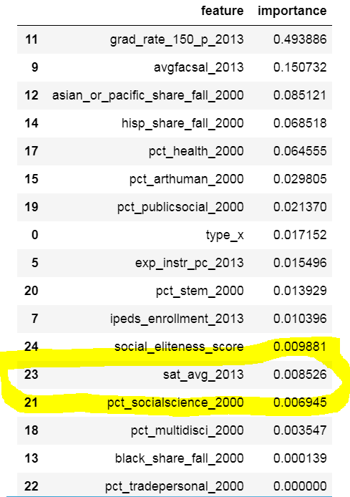
Use Binary Decision Tree Regressor to Determine Importance of SAT Scores
RMSE with SAT Scores = 0.2016
RMSE without SAT Scores = 0.1925
SAT Score is 13th Most Important Feature and garners little weight in overall prediction
Furthermore, RMSE deteriorates with SAT Score included
Conclusion: Exclude Average SAT Scores from Overall Model

Slide 6
Building Y-Variable to Predict
Data includes:
Parental Income Quintiles
Example: Par_q2 = Fraction of Parents in 2nd Income Quintile (2nd Lowest)
Student/Kid Income Quintiles [~age 30]
Example: K_q4 = Fraction of Students in 4th Income Quintile (2nd Highest)
Conditional Probabilities given starting Income Quintile
Example: kq5_cond_pq1 = % of Students ascending to 5th Quintile (Highest) given coming from the 1st Quintile
However, considering only these Quintiles would overlook & ignore other indicators of upward mobility
4) Student/Kid Salary Earnings Data [~age 30]
Primary Y-Variable Options (engineered)
Upward Mobility Score Calculation
K_median_nozero_adjusted (adjusted for cost of living)
staircase_score
upward_mobility_score
downward_mobility_score
shoots_and_ladders
(kq3_cond_pq1 + kq4_cond_pq2 + kq5_cond_pq3) X 1.0
(kq5_cond_pq2 + kq4_cond_pq1) X 1.25
(kq5_cond_pq1) X 1.5
No double-counting
Emphasis on large income leaps
Applied uniformly
= y-variable (dependent) in focus for study

Slide 7
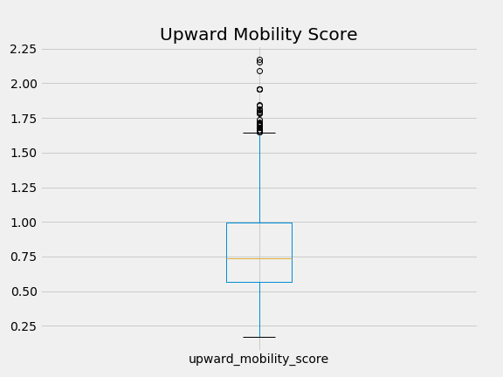
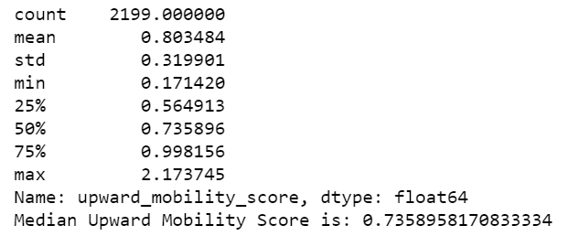
Upward Mobility Score: Right-Tail Skewed
→ Some Schools do a much better job at fostering Upward Income Mobility

Slide 8
Feature Engineering
Predict Missing Values for Critically Important Features, derived via Feature Importance, using Regressor Models. Keep actual values where applicable.
Sticker Price Predicted Values (KNN using Optimized K=20)
Rejection Rate Predicted Values (Random Forest w/ Optimized n_estimators = 320)
Is “Tech” School → Does the school have “tech” in the name?
Social Eliteness Score → What socioeconomic class does the student come from? As they say, “sometimes it’s not WHAT you know but WHO you know”. Calculation:
2*['par_top10pc’] + 1.5*['par_10-20pc'] + 1*['par_q4’]
Only takes Parent’s Income demographic into account; top-heavy weighted
“Bang for the Buck” Score (output)→ “Additional upward mobility unit per $ dollar of tuition spent”

Slide 9
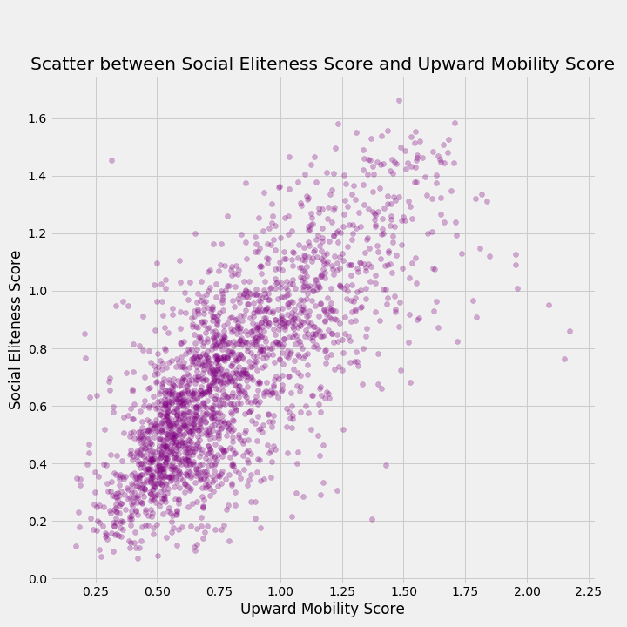
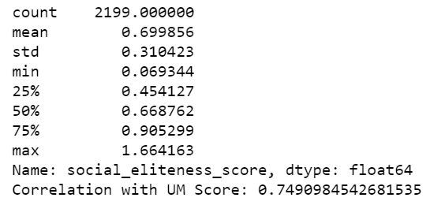
Social Eliteness Score: Strong Correlation with Upward Mobility Score;
“Environment” Factor

Slide 10
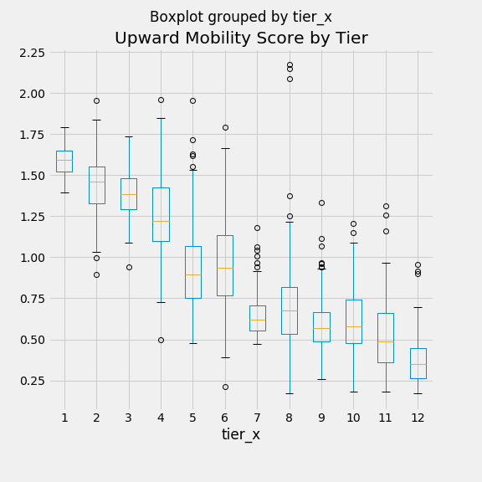
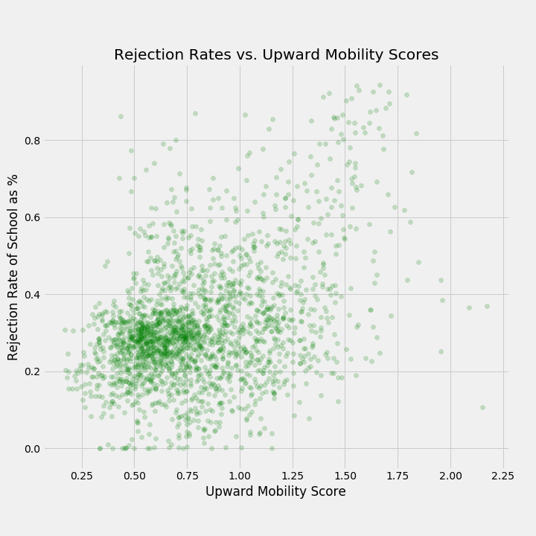
Let’s take a look at some Feature Relationships..
Tier 1 = Elite / Ivy League
Correlation = 41.0%
Tier 12 = Less than 2 year schools

Slide 11
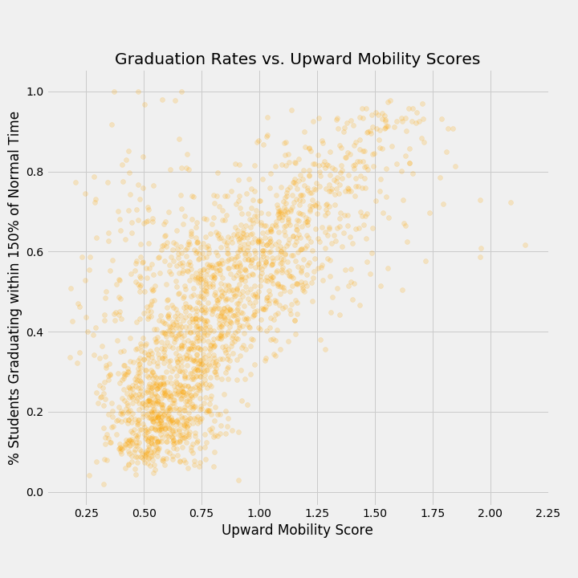
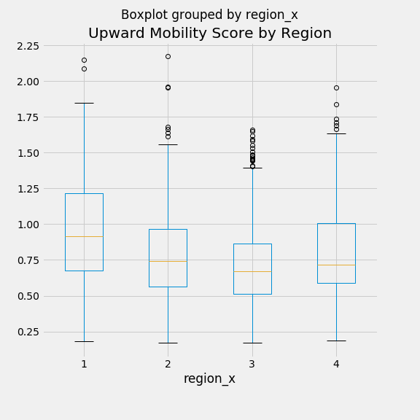
Region 1 = Northeast
Correlation = 68.8%
Region 3 = South

Slide 12
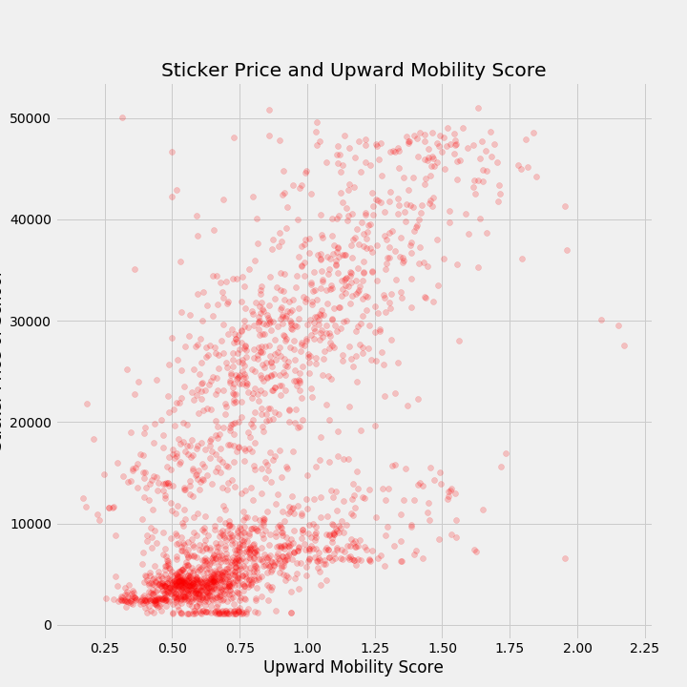
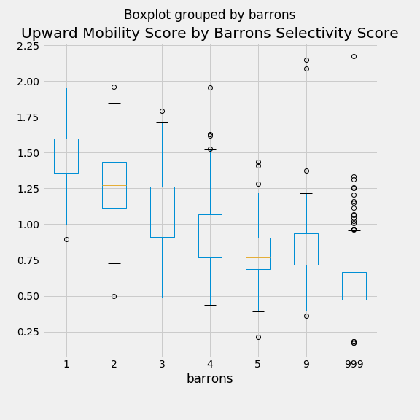
Level 1 = Most Selective
Level 999 = Non-selective
Correlation = 63.4%

Slide 13
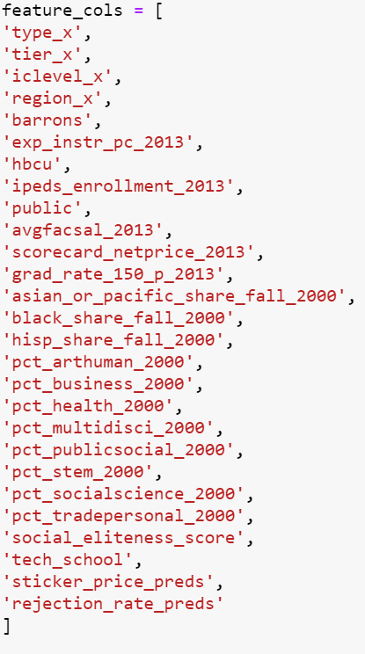


Let’s Build Some Models…
Classification
Upward Mobility Classification Buckets
Worst: 0.0 – 0.5 (330)
Below Average: 0.5 – 0.7 (648)
Medium: 0.7 – 1.0 (673)
Good: 1.0 – 1.3 (357)
Best: 1.3 – 2.5 (191)
OR
Regression
Engineered Features
…Standard Scaler Applied

Slide 14
Models Tested: Regression

Slide 15
Models Tested: Classification

Slide 16
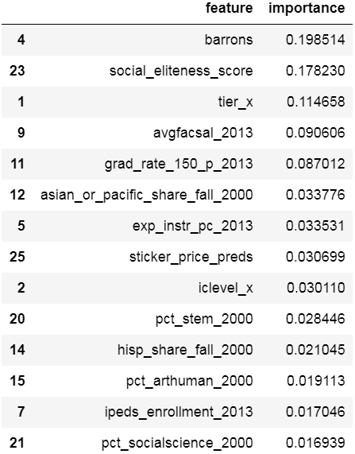
Feature Importance:
Random Forests Model
Barrons Selectivity Index, ranks as the top explanatory Feature. Perhaps this indicates the applicants innately vie for entry into colleges with high selectivity, knowing it leads access to mobility
Social Eliteness Score ranks second, indicating possible career opportunities and hence, upward mobility, may be determined by your environment and the people you surround yourself with
Tier of School, Graduation Rate and Average Faculty Salary round out the Top 5 Factors determining Upward Mobility

Slide 17
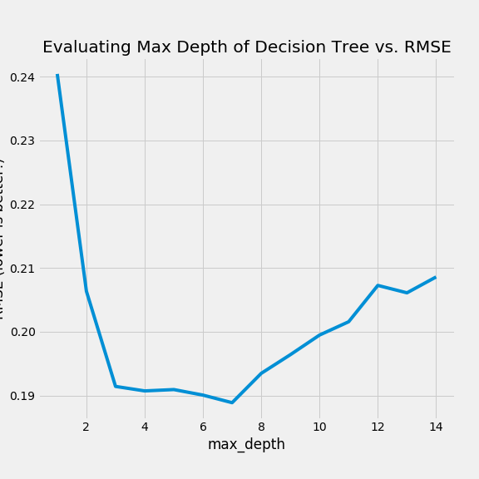
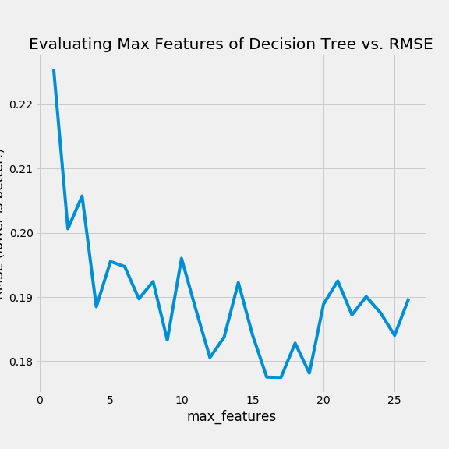
Hyperparameter Tuning:
Binary Decision Tree Regressor
Optimal RMSE = 0.1925
Max Depth = 7
Max Features = 18

Slide 18
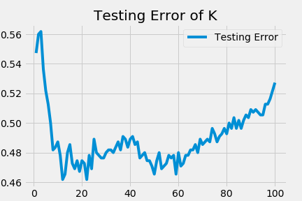
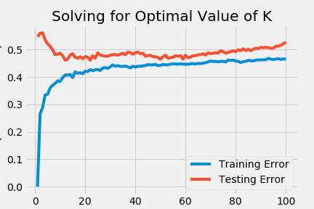
Hyperparameter Tuning:
KNN Nearest Neighbors Classifier
Optimal K = 23
Accuracy = 63.8%

Slide 19
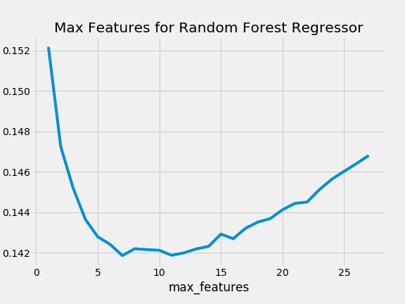
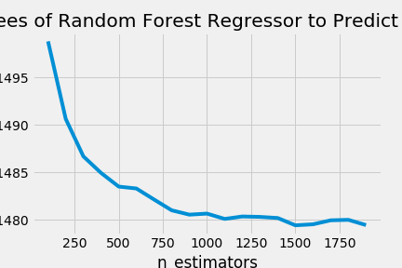
Hyperparameter Tuning:
Random Forest Regressor
Optimal RMSE = 0.1414
n_estimators = 900
Max Features = 10

Slide 20
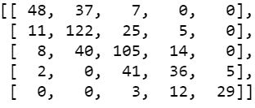
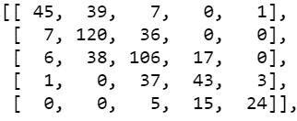
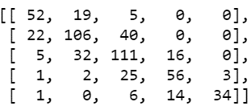
Evaluation between Classifier Models:
The Confusion Matrix (Testing Data)
Logistic Regression
KNN Nearest Neighbors
Random Forest Classifier

Slide 21
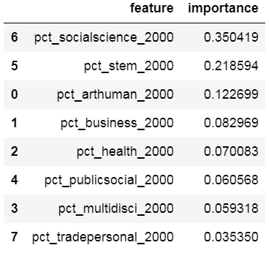
Just Curious…What if we only had “Majors” data to Predict Upward Mobility…
Interestingly, schools with a large percentage of Social Science Majors would be the most important feature to predict Upward Mobility
This is followed by STEM, Arts & Humanities and Business Majors as percentage of overall student body
Note: Binary Decision Tree Regression Model Used

Slide 22
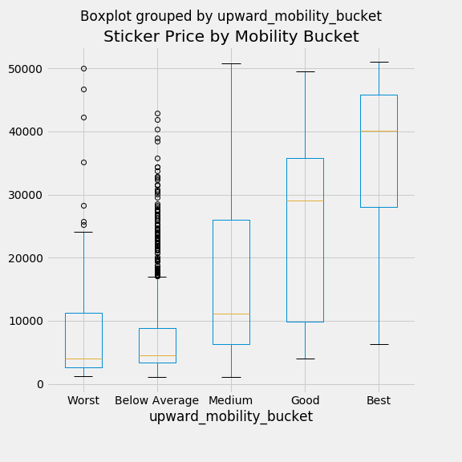
Interesting Observation:
Many Schools charge an Exorbitant Amount yet contribute little in the way of a Student’s Upward Mobility and Success.
Advice to Students: Stay away from these “over-inflated, underperforming schools”

Slide 23
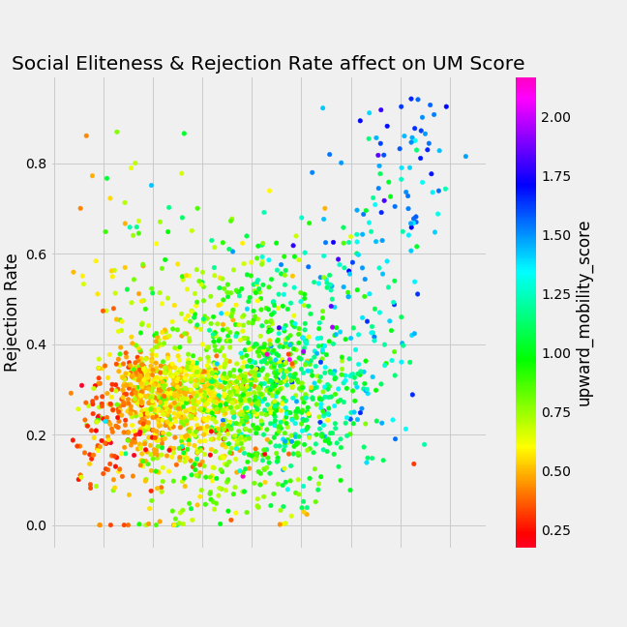
Interesting Observation:
High Social Eliteness Scores and High Rejection Rates – both highly correlated with each other – are strong explanatory variables in predicting Upward Mobility Score
Social Eliteness Score

Slide 24
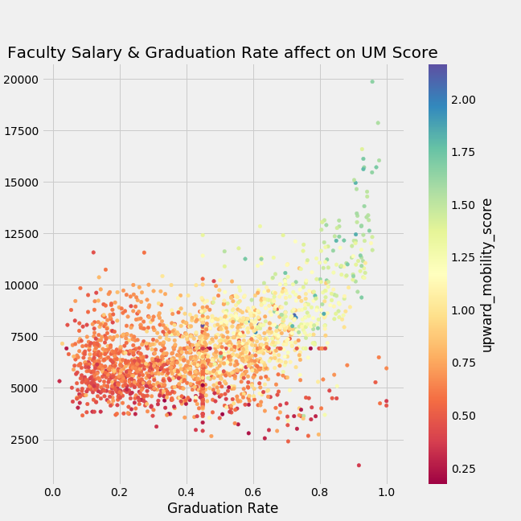
Interesting Observation:
High Faculty Salary and High Graduation Rates can significantly boost a school’s Upward Mobility Score
The UM Score accelerates with Higher Faculty Salary
Faculty Salary

Slide 25
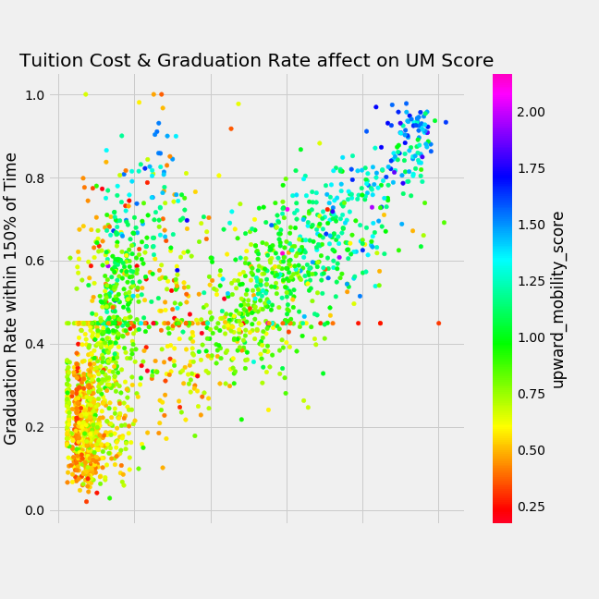
Interesting Observation:
The Data Says there are 2 Tracks towards gaining Upward Mobility:
1) More Expensive Option
2) Cheaper Option
Both rely on the School Attaining High Graduation Rates, regardless of Tuition Cost
Advice to Student: Graduate!
Tuition Cost

Slide 26
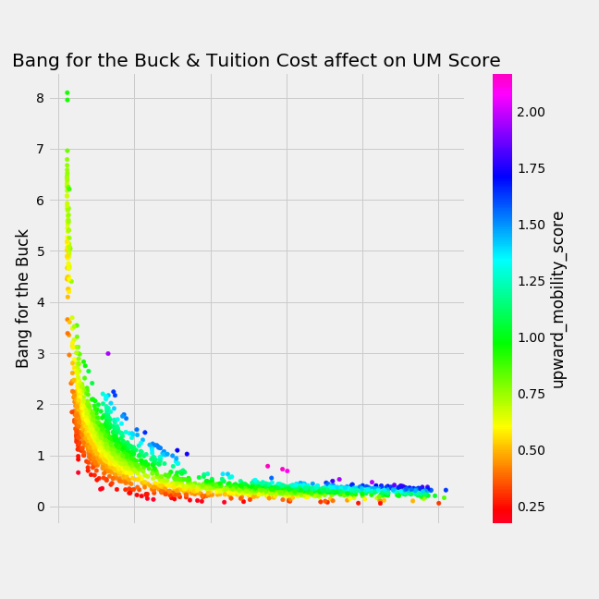
Interesting Observation:
There exists some schools with quality “Bang for the Buck” - meaning Low Tuition and high Upward Mobility Prospects – particularly at the Low Tuition Cost Level
Many of these are 2-Year Technical Colleges
Tuition Cost

Slide 27
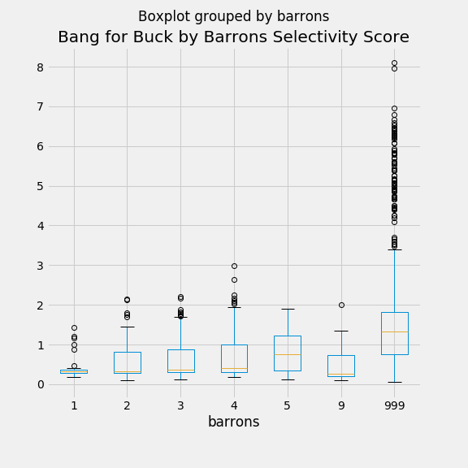
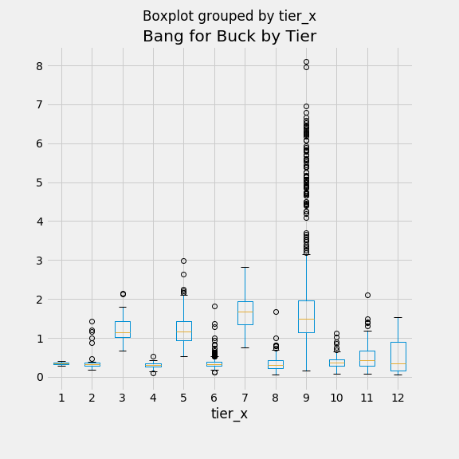
Interesting Observation:
There exists “value” college opportunities at any Tier or Level of Selectivity…
Here, Barrons 999 = Non-Selective & Tier 9 = 2-Year, Not-for-Profit College (Public & Private)

Slide 28
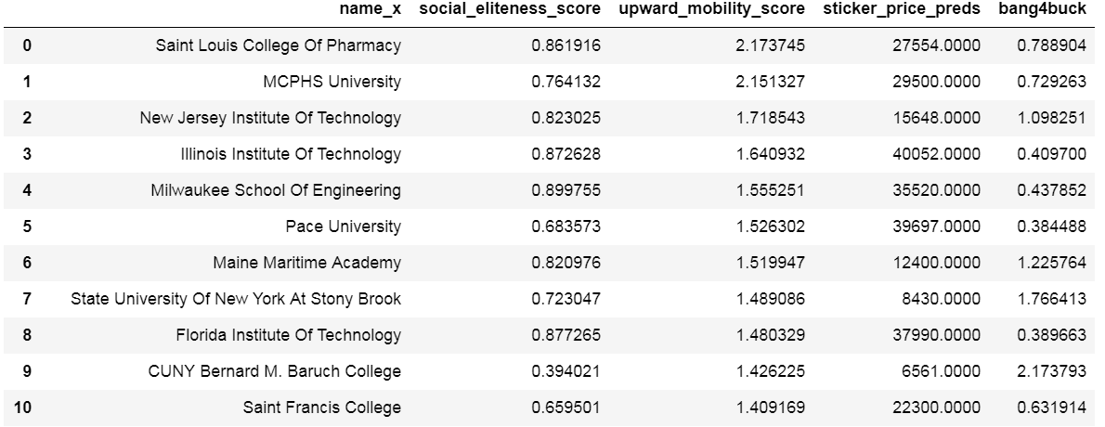
Highlighted Institutions:
High Upward Mobility (>1.0) despite Low Social Eliteness (<0.9)

Slide 29
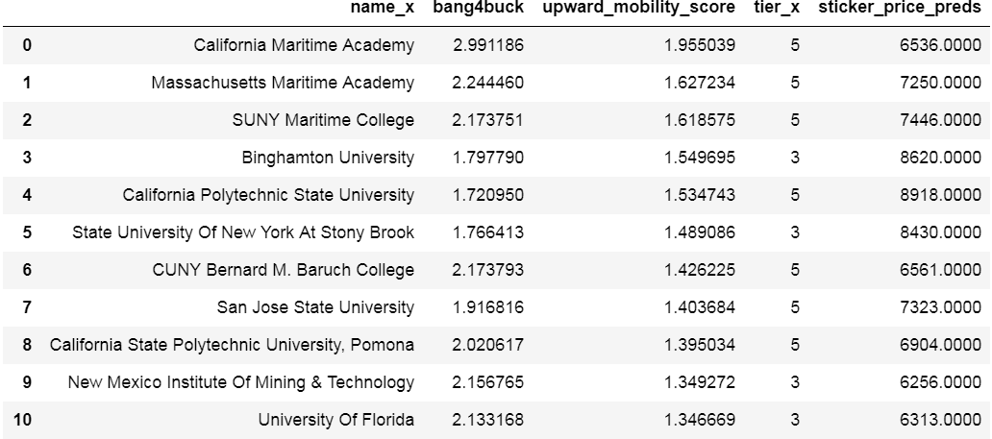
Highlighted Institutions:
Overall Best “Bang for the Buck” Schools (minimum UM Score > 1.0)
Note: Tier 5 Schools are “Selective Public”; Military, California & NY State schools well-represented

Slide 30
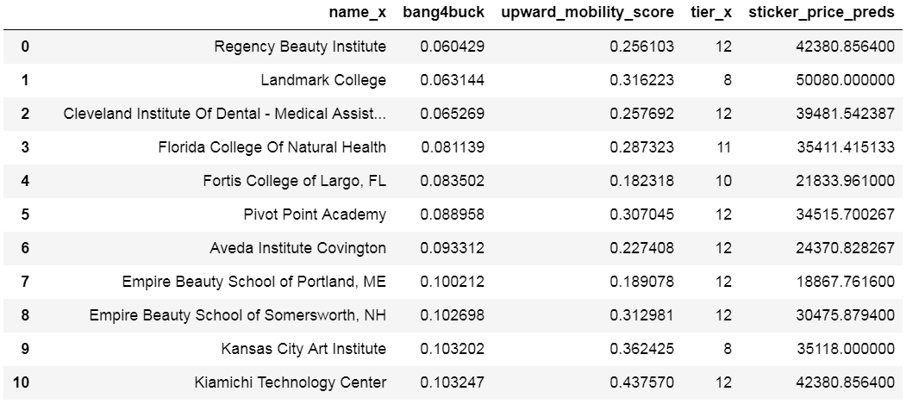
Highlighted Institutions:
Worst Bang for the Buck Schools (Warning: Stay Away!)
Note: Most are Selective Private Schools; Many “Beauty & Arts” Schools atop list

Slide 31
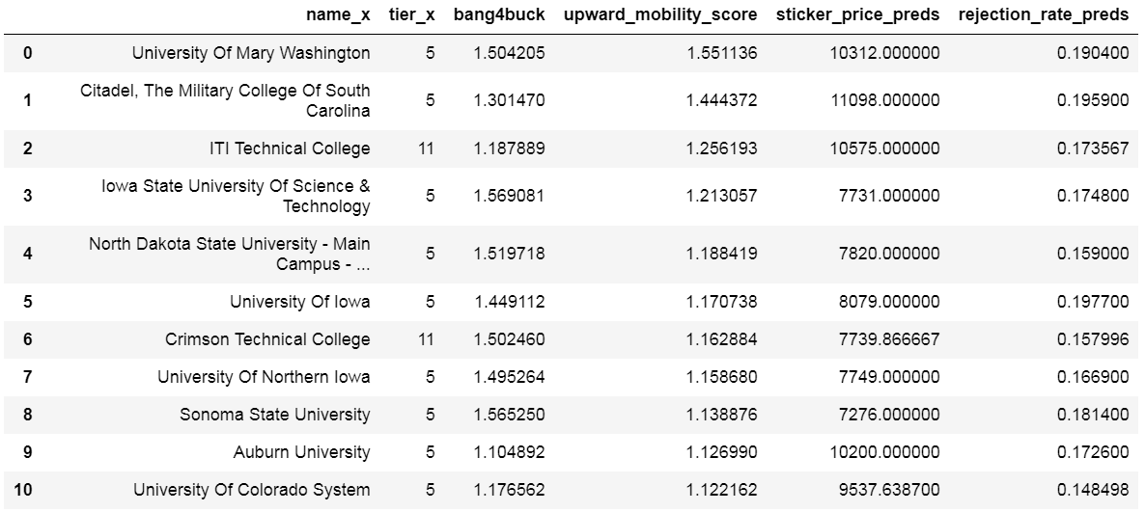
Highlighted Institutions:
Cheap, Non-Selective Schools that do well in Upward Mobility

Slide 32
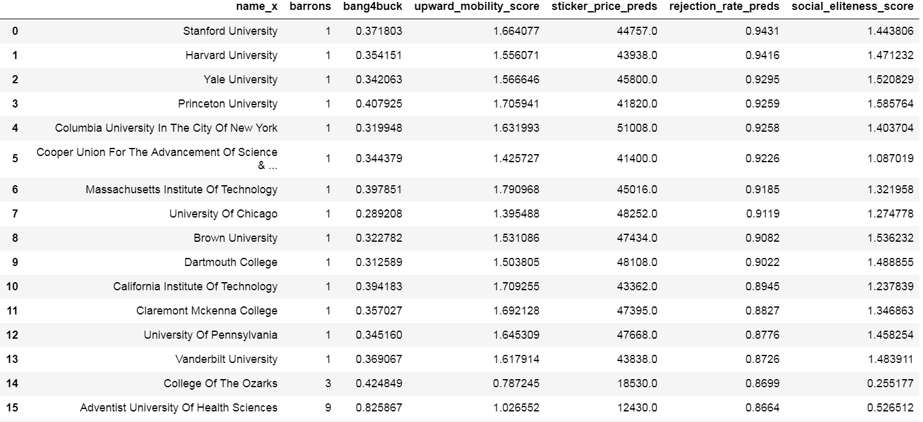
Highlighted Institutions:
The Most Selective Schools by Rejection Rate

Slide 33
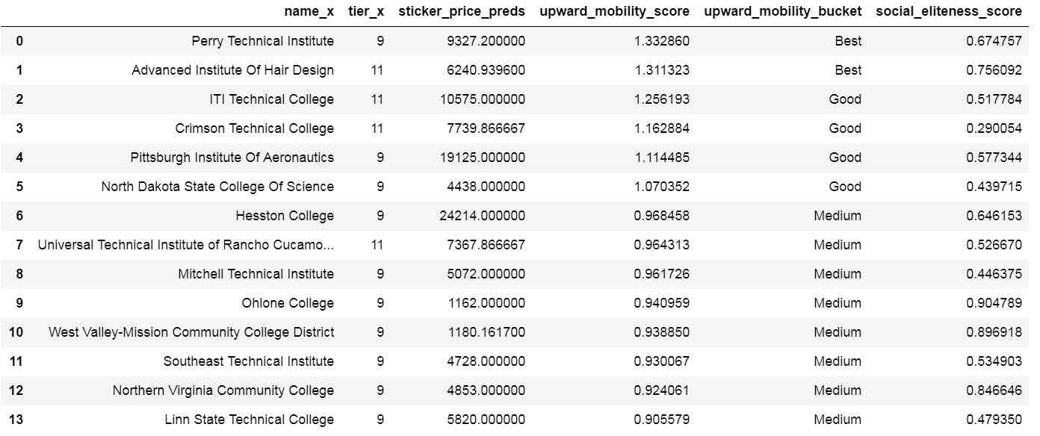
Highlighted Institutions:
2-Year Public Schools with High Rates of Upward Mobility
Note: Many Technical Colleges represented here

Slide 34
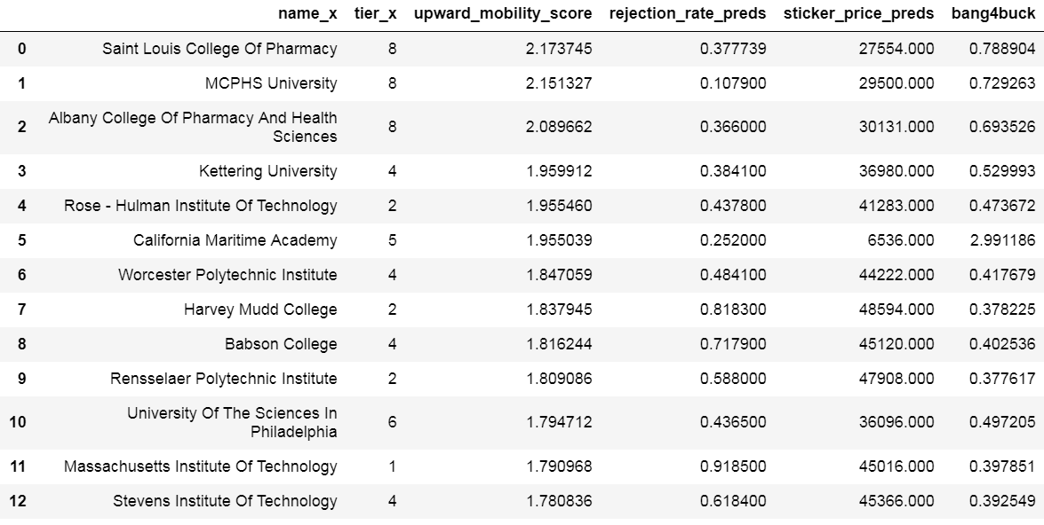
Highlighted Institutions:
…And finally…drum roll please…The overall BEST schools for Upward Mobility

Slide 35
Other Data that could be helpful & insightful
Classroom Size
Teacher-Student Ratio
Scholarship Opportunities (solves problem of burdening students with debt)
Financial Aid Packages available to students (ie. Avg Financial Aid)
Information from online MooCs & MicroMasters via edX, Coursera, Udacity, Udemy, Lambda School, General Assembly etc.
Internship Opportunities / On-Campus Recruiting / Alumni Engagement
Financial Debt upon Graduation (Liability side of Income Statement)
Global Universities & Institutions (More Comprehensive)
% of Students Matriculating to Graduate School

Slide 36
Conclusions & Key Takeaways
For Students:
From an individual standpoint, there’s nothing better to help your chances of achieving upward mobility than simply graduating college, regardless of which college you attend. Finish your degree!
Pay attention to the Selectivity of the school you’re applying for – this is the biggest determinant to enhancing your likelihood
Pay attention to the Social Eliteness Score of schools when applying for it may be the “environment you surround yourself with” that may help shape your future.
In order to get your “bang for the buck”, check out Military, Trade & Technical Schools that are lower cost yet have High Upward Mobility Scores. There are “value” options across the tier spectrum of schools
If you’re seeking to get a degree in an affordable & time-efficient manner, gravitate towards 2-year public & private not-for-profit schools
Stay away from Low Upwardly Mobile / High Cost Institutions

